Slide 1
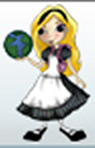

Alice Programming
Notes:
Alice allows you to program using drag and drop instructions to create 3D animations.

Slide 2
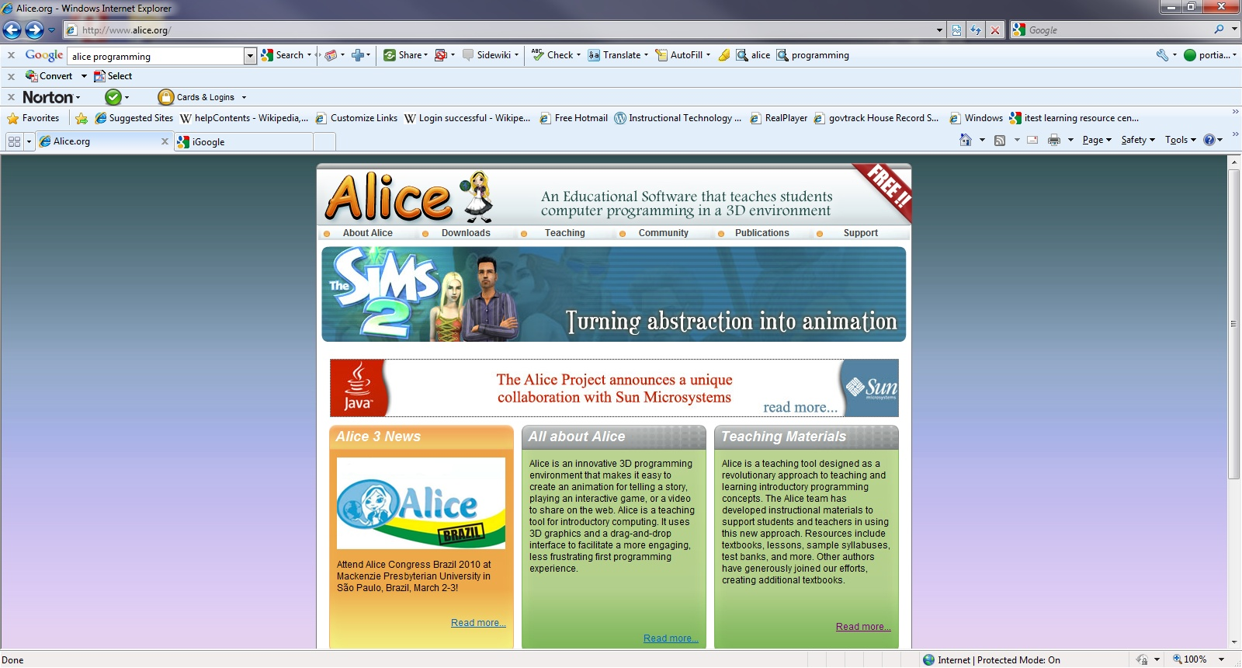
alice.com
Carnegie Mellon University with support from Electronic Arts, Sun Microsystems, DARPA, Intel, Microsoft, NSF and ONR.
Notes:
Alice began development at the University of Virginia and then was finished and improved at Carnegie Mellon. The group at Carnegie Mellon was led by the late Randy Pausch (of “the last lecture). Alice is open source meaning that their source code is available for you to be able to change.

Slide 3
Alice 3D Programming Environment
Drag and Drop instructions to create:
  Animations
  Interactive Games
  Videos
  Movies

Slide 4
Computational Thinking
Promotes problem solving skills
Learn basic computer science
  Algorithmic thinking and expression
  Decompose problems logically
  Methods, functions, variables, parameters, recursion, arrays and events
Eliminates the frustration of syntax errors
Introduces object oriented programming
  Bundles functions and procedures into objects each with specific roles or responsibilities
Notes:
Alice was developed to teach programming theory without the frustration of syntax errors. It was designed to function more as an environment to tell stories rather than a programming environment. There is a version of the software written by a PhD student called Storytelling Alice that is even more story focused and is more appropriate for middle school children. Both Alice and Storytelling Alice are Integrated development environments which means it is a source code editor, a compiler, build automator, and a debugger all in one.

Slide 5
Programming Process is the Same
Read
  Collect information about the problem you are solving or brainstorm a story idea
Design
  Write out the Pseudocode or make a storyboard
Implement
  Write the program or story
Test
  Run the program or watch the story
Notes:
Even though this is a storytelling process the programming development process is the same. But with reluctant programmers, you can you the non-threatening story building vocabulary such as brainstorm, storyboard, write the story, and watch the story. The testing and implementing process is a recursive process.

Slide 6
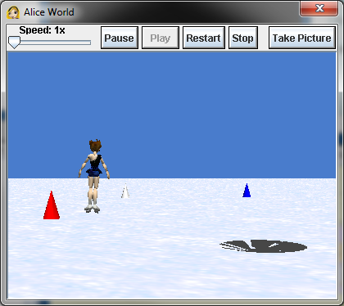
Skater Tutorial

Slide 7
What are the objects?
Setting
  Tree, house, fence, furniture, building, props
Actors
  People, animals, vehicles
Notes:
Alice programming is an object oriented programming environment. Recall that object oriented programming is defined as: Bundles functions and procedures into objects each with specific roles or responsibilities. So, what are the objects? As you saw each of the objects that you can put in the environment have things that they can do.

Slide 8
You are the director
You tell your actors where to go and what to do in the setting.
  Yes! You are programming…but don’t tell your students that!
And you begin with a script….
  Programmers call this pseudocode
Notes:
So you are the director, and you can tell those objects what to do. As it turns out, girls do not sign up for programming courses when they are called computer programming…but if you call it computer scripting… they do.

Slide 9
You can start with a pencil and paper…
In order to tell the story you need to answer the following questions
  What story is to be told?
  What objects will be needed?
    Setting objects
    Actor objects
  What action will take place?
Notes:
You have this outline in your handout. Let’s just sketch something out together based on the video we watched.

Slide 10
Script
  What story is to be told?
    An ice skater skates around cones as they are clicked and falls into a hole when it the hole is moved in her path before she can skate around the last cone.
  What objects will be needed?
    Setting objects
      Snow background, three cones, hole
    Actor objects
      Ice skater
  What action will take place?
    Skating around selected cone
    Falling in the hole
Notes:
I will leave this up so we can refer back to if we need to ….So, lets load up the Alice program and get to work!

Slide 11
Let’s Get to Work!
Notes:
Open Alice Program and walk through the tutorial.

